Slide 1
Data Mining
SHILPA LAKHANPAL

Slide 2
Machine Learning Algorithms
Machine Learning algorithms can be classified into two types namely
Supervised Learning: The training data (observations, measurements, etc.) are accompanied by labels indicating the class of the observations. New data can be classified based on the training set.
Unsupervised Learning: The class labels of training data is unknown. Given a set of measurements, observations, etc., the aim is to establish the existence of classes or clusters in the data.
[1]

Slide 3
Supervised Learning
Regression: is appropriate when we are trying to predict continuous valued output such as stock or housing prices.
Price ($)
in 1000’s
Size in feet²
[1]

Slide 4
Supervised Learning
Classification: is appropriate when we are trying to predict one of a small number of discrete valued outputs such as benign or malignant tumors or whether or not it will rain tomorrow.
Malignant?
1(Y)
0(N)
Tumor Size
[1]

Slide 5


Supervised Learning
Find a decision boundary to classify the data
Given a labeled training set
Training set:
[1]
Labels

Slide 6
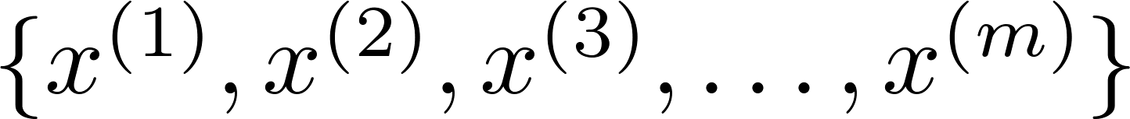
Unsupervised Learning
One structure is to group the points into two separate clusters
Give this unstructured data to an algorithm to find a structure
Training set:
No Labels y
[1]

Slide 7
CLUSTERING
An unsupervised learning technique

Slide 8
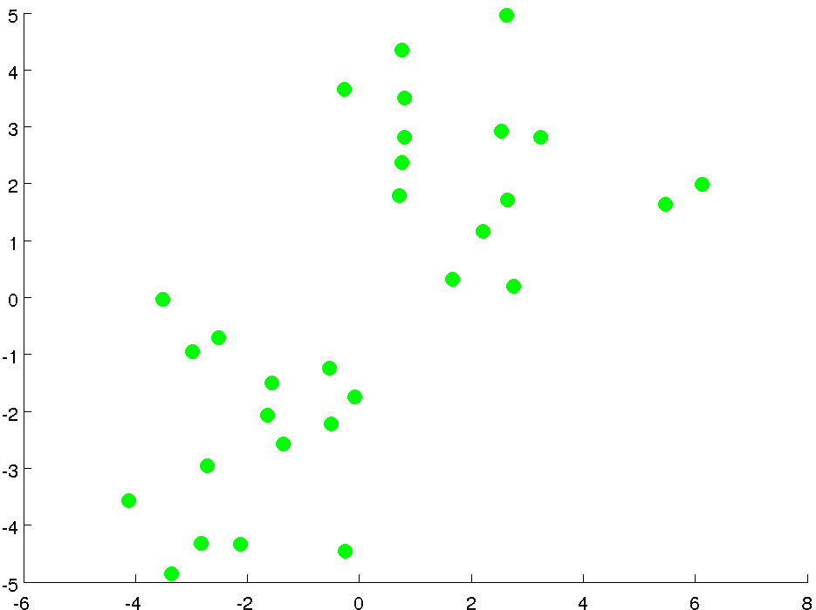
Clustering Algorithm: K-Means Algorithm
Initialization Step:
Randomly initialize two points called the cluster centroids
[1]

Slide 9
K-Means Algorithm : Iterative Algorithm
First Step: Cluster Assignment
For each of the green data points, depending on which is it closer to (red or blue centroid), assign that point to its corresponding centroid.
[1]

Slide 10
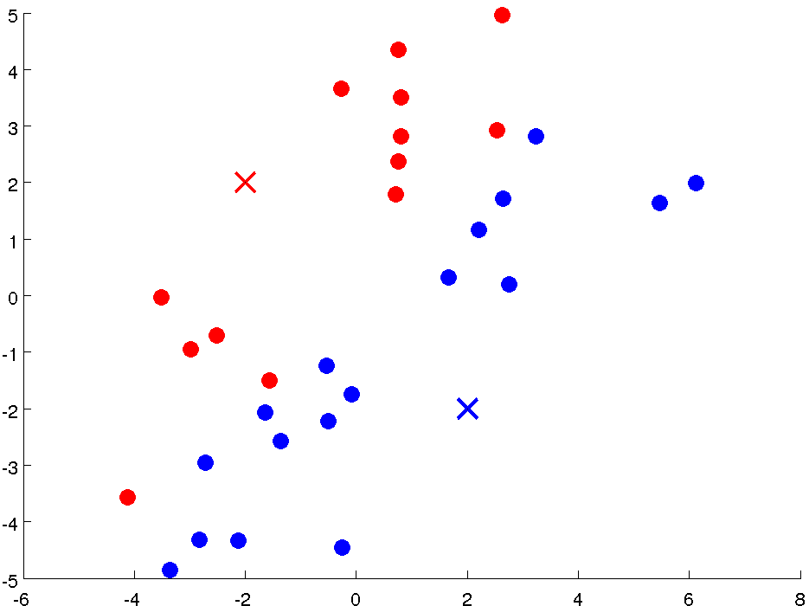
K-Means Algorithm : Iterative Algorithm
Specifically, its going to color the data points depending on their proximity to the centroids
[1]

Slide 11
K-Means Algorithm : Iterative Algorithm
Second Step: Move Centroid
Compute the average (mean) of the position of the red data points and move red centroid to that position. Similarly for the blue centroid
[1]

Slide 12
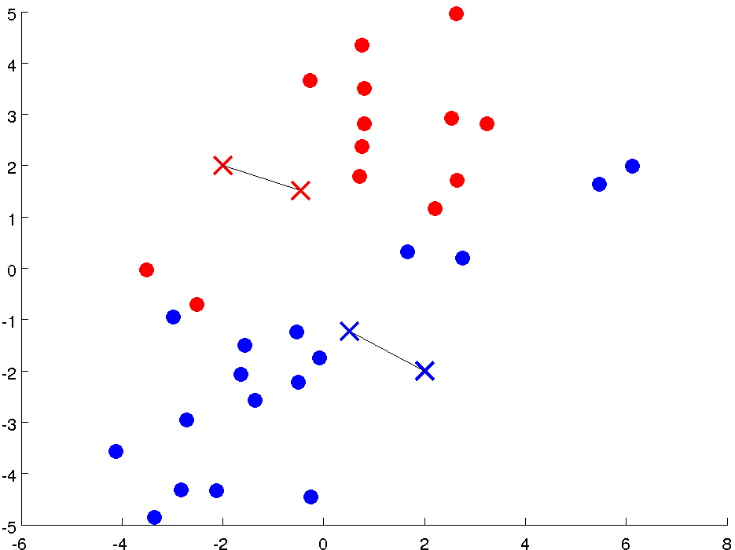
K-Means Algorithm : Iterative Algorithm
Repeat First Step: Cluster Assignment
For each of the data points, depending on which is it closer to (red or blue centroid), assign that point to its corresponding centroid.
Specifically, its going to color the data points depending on their proximity to the centroids
[1]

Slide 13
K-Means Algorithm : Iterative Algorithm
Repeat Second Step: Move Centroid
Compute the average (mean) of the position of the red data points and move red centroid to that position. Similarly for the blue centroid
[1]

Slide 14
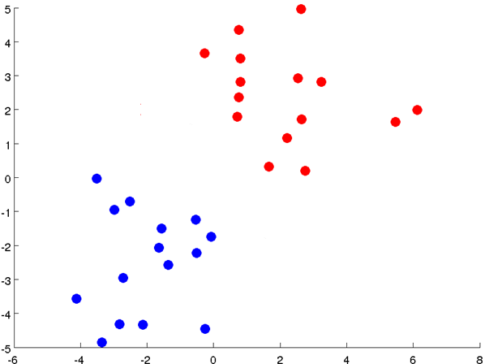
K-Means Algorithm : Iterative Algorithm
Repeat First Step: Cluster Assignment
For each of the data points, depending on which is it closer to (red or blue centroid), assign that point to its corresponding centroid.
Specifically, its going to color the data points depending on their proximity to the centroids
[1]

Slide 15
K-Means Algorithm : Iterative Algorithm
Repeat Second Step: Move Centroid
Compute the average (mean) of the position of the red data points and move red centroid to that position. Similarly for the blue centroid
Eventually, Algorithm converges. If we keep running the algorithm, the cluster centroids would not change any further
[1]

Slide 16

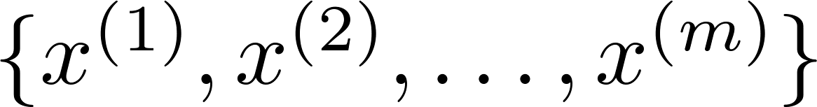
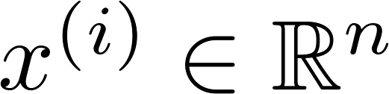
K-Means Algorithm
Input:
(number of clusters)
Training set
[1]

Slide 17

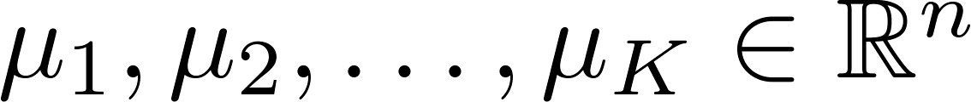
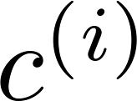
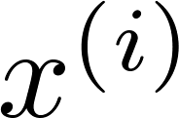

K-Means Algorithm
Randomly initialize cluster centroids
Repeat {
for = 1 to
:= index (from 1 to ) of cluster centroid
closest to
for = 1 to
:= average (mean) of points assigned to cluster
}
Cluster Assignment Step
Move Centroid Step
[1]

Slide 18

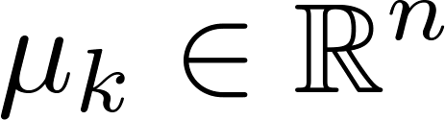

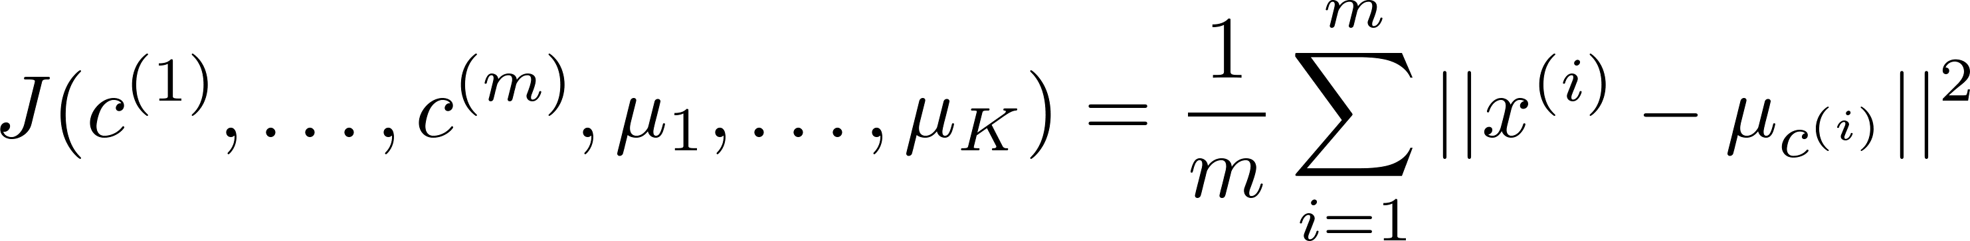
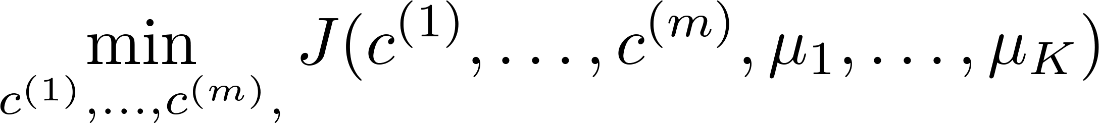

K-Means Optimization Objective
= index of cluster (1,2,…, ) to which example is currently assigned
= cluster centroid ( )
= cluster centroid of cluster to which example has been assigned
Optimization objective:
[1]

Slide 19
Problem with Random Initialization: Local Optima
[1]

Slide 20
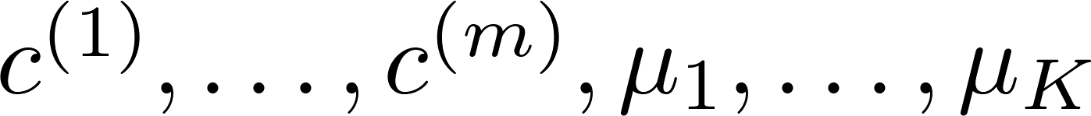
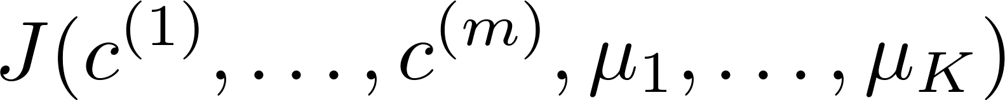
Random Initialization
For i = 1 to 100 {
Randomly initialize K-means.
Run K-means. Get .
Compute cost function (distortion)
}
Pick clustering that gave lowest cost
[1]

Slide 21
What is the right value of K ?
[1]

Slide 22

Choosing value of K
Elbow method:
Ambiguous…no defined elbow
Elbow
Cost function
Cost function
(no. of clusters)
(no. of clusters)
[1]

Slide 23
Choosing value of K: Based on Requirement
Sometimes, you’re running K-means to get clusters to use for some later/downstream purpose. Evaluate K-means based on a metric for how well it performs for that later purpose.
E.g.
XL
T-shirt sizing
T-shirt sizing
L
L
M
M
S
Weight
Weight
S
XS
Height
Height
[1]

Slide 24
Class Activity: Cluster the items using K-Means
 | Feature 1 | Feature 2
Item 1 | 1 | 1
Item 2 | 2 | 1
Item 3 | 4 | 3
Item 4 | 5 | 4
K = 2
Initial Centroids = (1,1), (2,1)

Slide 25
References
Machine Learning: Dr. Andrew Ng, Stanford

